Slide 1
Shell Bootcamp 2024 3 Reflections for Week
Sriya Nukala
Date : 6-Sept-2024

Slide 2

About Me
Continuous learning fuels endless growth. Looking forward to working and connecting with inspiring people.

Slide 3

My learnings from this week!

Slide 4
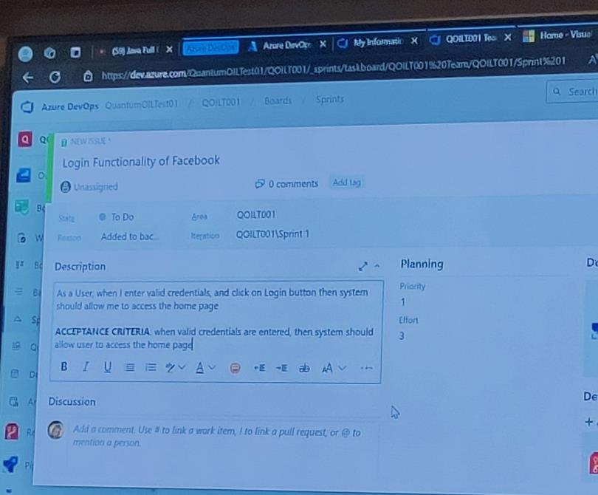
Learning 1 | My takeaways
User Stories
I learnt many concepts such as Software Project Management, Phases of SDLC, Critical Aspects of Project Development, Testing triangle, User Stories.
As every sector have projects to implement, it is very important to know the process of SDLC, how to write user stories from SRS Document.

Slide 5
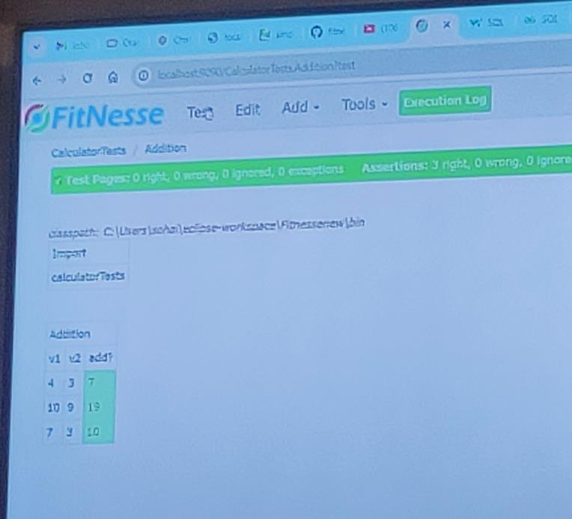
Learning 2 | My takeaways
STLC, types of testing and fitnesse tool
Software Testing Life cycle is a subset of Software Development Life cycle , what are the phases of STLC , the types of testing that are done in different phases of software testing hierarchy, fitnesse tool.
In energy sector there are many IT projects which should go through STLC, which includes writing of test cases for the user stories that are defined.

Slide 6
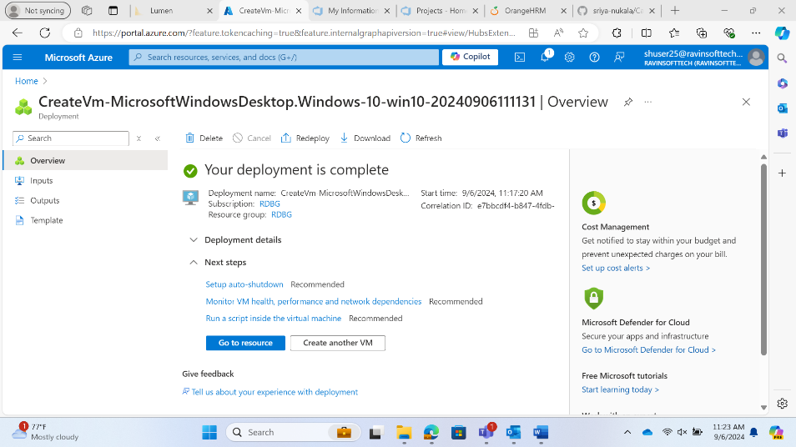
Learning 3 | My takeaways
Bug Reports and Creating Azure VM
I learnt process to identify a bug, bug report, types of bugs that we would encounter, stages of Bugs and how to create Virtual Machine in azure.
There are different phases of bugs such as new, assigned, open, fixed, pending retest, closed. The bug report should include Bug id, description, steps to reproduce, expected, actual result, assignee. There are several steps that includes creation of VM. First giving details such as name and other details, configuration of disks, networking and then deploying.

Slide 7

Relevance of learnings for my organization

Slide 8
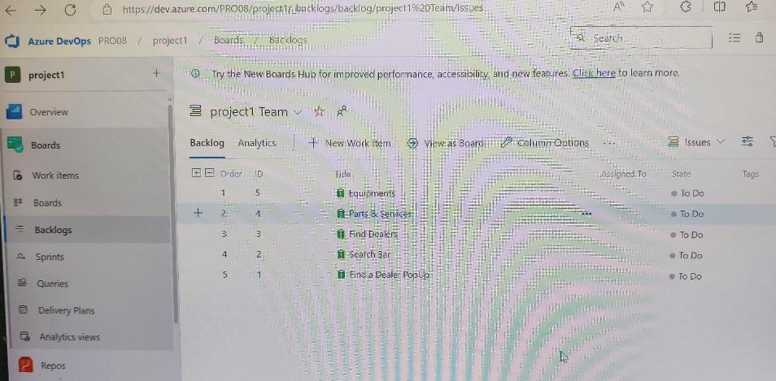
Learning 1 | Relevance for Shell
When a project is going to start any organization should have BRD and SRS documents, from SRS document Product Owner will be creating user stories. So, it is important to know how to write user stories and what is the acceptance criteria and how to estimate the time required and priority. As shell also have some IT projects going on so shell will implement this learning.
If everyone has an idea about what user story is, then it will be beneficial for the developers of the organization to concentrate more on the development part instead of spending more time on this part.

Slide 9
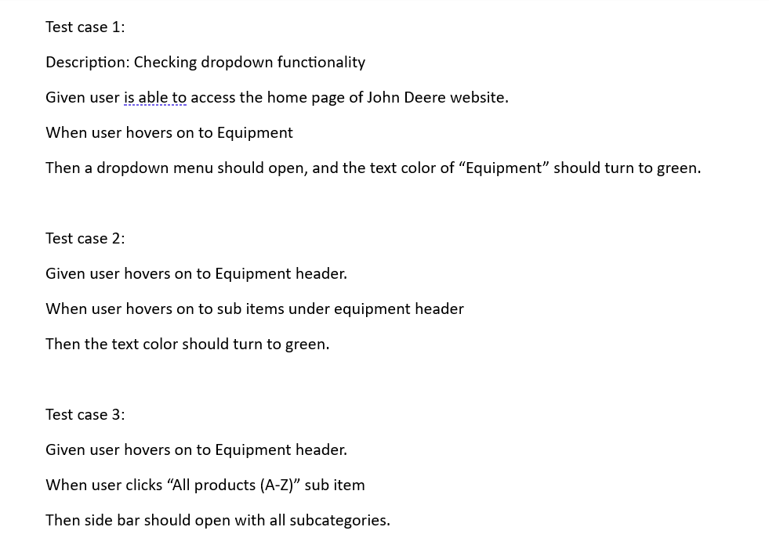
Learning 2 | Relevance for Shell
As a part of every project after creating user stories it is important to write test cases for these user stories which is a part of testing. So, shell implements this learning as a part of every project.
Writing test cases is very important part of any technical project. If we miss on any one of the test case it might effect the user experience of the application. So, if all the employees know about this then it will be easy for the organization to deliver a good efficient product which in turn benefits the organization.

Slide 10
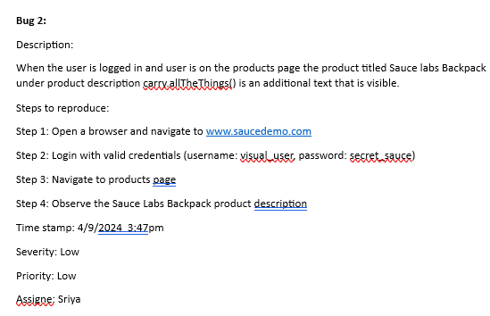
Learning 3 | Relevance for Shell
After writing the testcases, QA engineers will execute these testcases and record the results of each test case. If any test case fails, then it means there is a bug in it. Bug is an issue that should be immediately addressed as it might affect the user experience of the application. So, it is important that every QA engineer should be able to write a bug report and assign it to a developer based on the severity of the bug.
As bugs are critical part of the application which directly affects the user experience, it is very important that should be immediately addressed. So, if employees know how bug affects the organization, then they will make sure that it is immediately fixed which benefits the organization.

Slide 11

Challenges in implementing learning

Slide 12
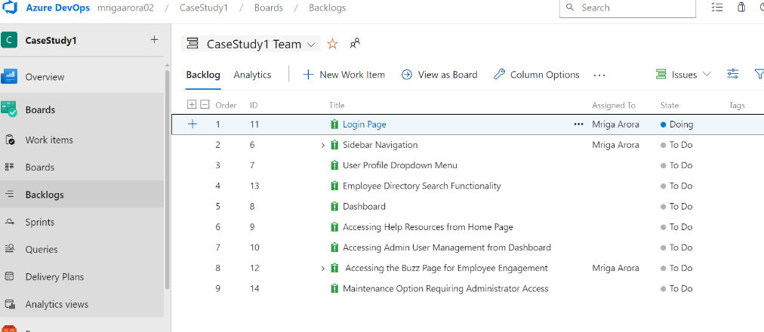
Challenge faced while implementing Learning 1
When I was writing user stories for the website that is given at first, I was confused between user stories and test cases later I got to know the difference between them. Then I was able to distinguish between user stories, sub tasks. And I was also able to write the acceptance criteria for each user story. I also learnt how to write estimate and priority of each test case.

Slide 13
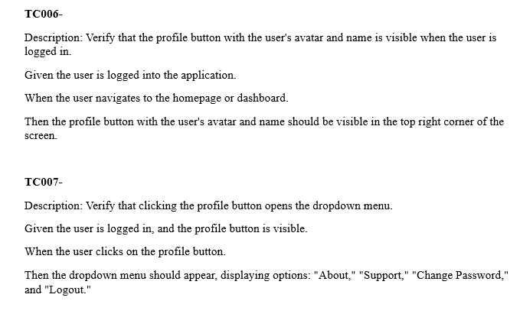
Challenge faced while implementing Learning 2
When I was writing test cases from a user story I faced challenges such as understanding the requirements, dealing with incomplete specifications, and ensuring it covers all possible scenarios. To overcome these challenges, we have discussed among ourselves about what to cover under each user story. We have also discussed about the edge cases that are possible. In this way I overcame this challenge.

Slide 14
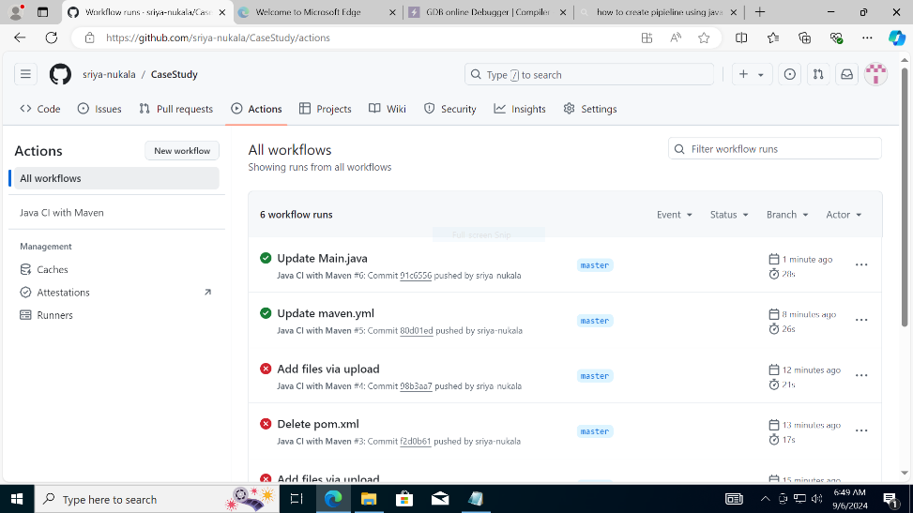
Challenge faced while implementing Learning 3
Finding bugs was easy but I faced challenges while creating VM. First VM was not created as the zone which I selected was full, again I selected another region then I was able to create it. Then I added a basic java code and then when creating workflow, I was getting some error regarding a file that needs to be in the repo ie pom.xml file. Then I added this file and run the build then my build was run successfully.

Slide 15

Action Plan

Slide 16
My Action Plan for this Week
Actions
Timeline
Status
I wanted to know more about SDLC and other topics that are involved in the project management.
This week
I learnt many new concepts in this week which will be helpful for my growth

Slide 17

Learning is also Fun!

Slide 18
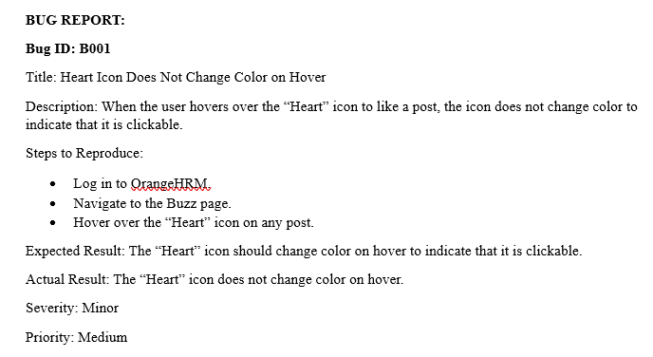
Learning is also Fun!
The fun activity was finding bugs in the given website. We had a lot of fun in that task.

Slide 19

Summary
I learnt many new concepts such as SDLC, STLC, User stories, test cases, bugs, bug reports, types of bugs, phases of bugs, Cloud concepts, creating virtual machines, creating build using Java with maven tool on GitHub. I also got to know the whole project timeline, what are the steps involved in each phase, how to plan sprints, how to estimate the time required for each sprint, what is meant by Agile scrum, fitnesse tool and all the important things are covered. I personally feel that this week has been very important and informative week where I got to know many things and understood the importance of them.

Slide 20
Thank You

